Slide 1
Opinion Essay Writing
by
Hagit Cohen

Slide 2
There are different kinds of
opinion essays:
agree / disagree
One opinion essay
Two opinions essay
advantages (pros)/ disadvantages (cons)
For& Against

Slide 3
Pre Writing
Read the instruction carefully and understand the task.
Brainstorm for pros/cons or advantages/disadvantages/ reasons and arguments.
Draw a table if needed to write down the two points of view.
Make sure that you have enough arguments for your opinion.

Slide 4
Step 1-Inroduction
In the introductory paragraph, you need to present the topic and state your opinion clearly.
Make sure to begin with a general statement that present your topic.
The first sentence of the introductory paragraph is very important since its role is to attract the reader.
You can either start with a rhetoric question, a nice riddle or story, a quote from a book, an idiom, or a scientific surprising fact.

Slide 5
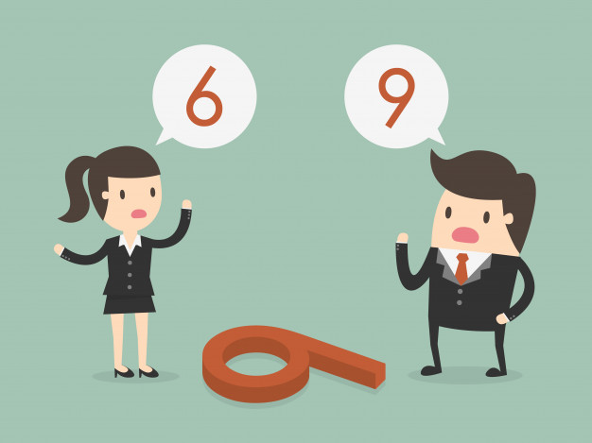
The second sentence should introduce or present the topic.
The third one, should show the different points of view.
The last sentence must show your point of view (it can be by using first person pronoun or by using markers of opinion).
You can use the following expressions: I believe, in my opinion, unfortunately or fortunately, I strongly believe, I think, etc.

Slide 6
An example of an
introductory paragraph
Have you ever thought leaving Israel and immigrating to another country? Well, I have. Israel is our hometown and living in it has its pros and cons. Some people will choose to stay in Israel for ever, others might prefer to live in another country. If you ask me, I prefer living in Israel.

Slide 7
Just checking☺
Write an introductory paragraph for the following topic:
Some people claim that some jobs fit only men or women. What do you think?
State your opinion using evidence and examples.

Slide 8
STEP 2- THE BODY
The body of the essay includes between 2-3 paragraphs supporting your opinion. Each paragraph should include 4-5 full sentences.
Each paragraph should elaborate on a different argument.
If it is a one opinion essay, each paragraph should elaborate on a different reason for holding this specific opinion.
If it is a two opinions essay, each paragraph will be on a different opinion.
If you want to strengthen your opinion, you should write more arguments for this opinion.

Slide 9
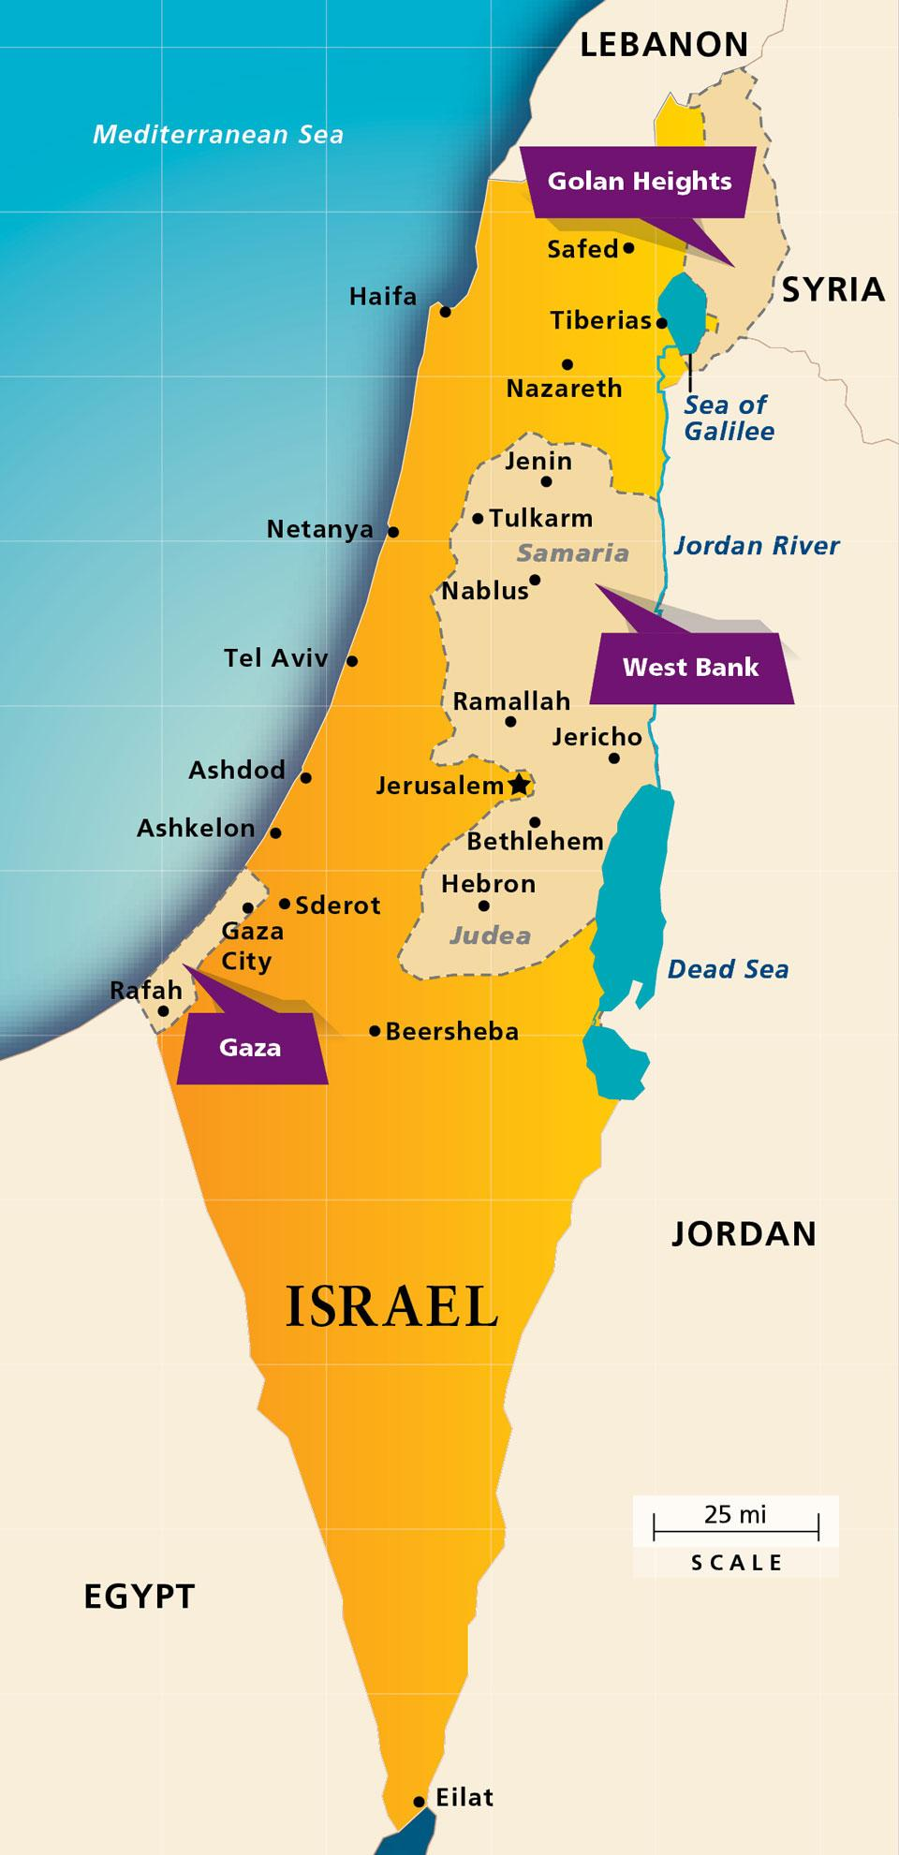
How should you divide
your paragraphs?
One opinion essay
Two opinions essay
Israel, our hometown, is the most secure place on Earth for us.
Israel has some beautiful views and places that are important for all religions.
Israel has a very good and effective medical system.
cons | pros
It is surrounded by enemies. | Israel is the most secure place on earth
It is very expensive to live in Israel. | Israel has a very good medical system.

Slide 10
THE CONCLUDING PARAGRAPH
To conclude your opinion essay, write a paragraph where you restate your opinion using different words.
You should avoid introducing a new idea or apologizing for your views.
However, to make your essay more engaging, you can end with a warning, ask a provocative question or suggest consequences or recommendations.

Slide 11
Example for a
concluding paragraph
In conclusion, in light of the above it is obvious that living in Israel can be seen by some as very challenging, while others, like me, are very patriotic and will never live Israel . In my opinion, this is my homeland and since the advantages presented here outweigh the disadvantages, I intend to stay here.

Slide 12
WE USE SOMETHING TASTY TO REMEMBER THE STRUCTURE OF AN OPINION ESSAY:
Explanation | What it stands for?
We state our opinion in the beginning of the essay. | Opinion | O
The body of the essay includes both reasons (arguments for or against, for example.) | Reasons | R
Supporting details of the reason mentioned above | Examples | E
We rephrase our opinion in other words than in the introductory paragraph | Opinion | O
O
R
E
O

Slide 13
While writing, pay special attention to:
Grammar – normally you should use present tenses in this type of essays, but pay attention to the different grammatical structures you are required to use.
Linking words/ connectors – use different expressions for giving reasons (one reason for ... is / many people believe that... / since... / due to...), expressions of opinions (in my opinion... / I am convinced that... / from my point of view...), adding ideas (first of all.../ secondly... / moreover, …/ in addition/ finally... ), etc.
Formal vocabulary – do not use abbreviations or slang.
Punctuation – learn the English punctuation rules.

Slide 14
The criteria you are graded on
Mechanics | language | vocabulary | content
Correct use of: Spelling Punctuation Capitalization Paragraphing | correct use of basic tenses and/or language structures correct use of advanced language structures correct word order correct use of parts of speech, pronouns and prepositions. | Correct and varied use of vocabulary items. Suitable register. | All information is relevant The essay is fully on topic Task is understood, organized and coherent.

Slide 15
An opinion essay about Fast Food

Slide 16
Punctuation Rules
1. Commas (פסיקים)
Come after a connector which starts a sentence or a paragraph.
I can’t stop coughing. Therefore, I plan to stop smoking.
After an element which comes in front of the first independent clause in a sentence.
After 16 years of smoking, it is not easy to quit.
Together with a coordinating conjunction (connector) which connects the two clauses in a complex sentence:
She has a good job, yet she is always broke.
My uncle, however, refuses to quit smoking.

Slide 17
Coordinating conjunctions
We also use commas before coordinating conjunctions when they connect between two simple sentences in a complex sentence:
I am a little hungry, for I didn’t eat breakfast. | for | F
John likes to fish, dance, and hunt. | and | A
She doesn’t eat meat, nor does she drink milk. | nor | N
I like to swim, but I don’t know how. | but | B
Do you prefer coffee, instant coffee, or tea? | or | O
It is sunny and warm, yet you should still take your jacket. | yet | Y
I didn’t eat breakfast this morning, so I am a little hungry. | so | S

Slide 18
Using Semicolons(;)
Used in 3 places:
1. Between two sentences that are closely connected in idea.
Andrew didn’t accept the job offer; he wants to go to graduate school.
2. Before a transition phrase as however, therefore, nevertheless, but, moreover, furthermore…
Skiing is dangerous; nevertheless, millions of people ski.
3. Used to separate items in a series when some of the items already contain commas.
I cannot decide which car I like best: the Ferrari, with its speed and sporty look; the midsize Ford, with its beautiful looks; or the compact Geo, with its economical fuel consumption.
4. Used before giving examples using the connectors: for example, for instance.
I am a very independent kid. I do a lot of activities by myself; for example, I dress, eat, take a shower, etc.

Slide 19
Colons (:)
After a colon we often write lists.
I need the following ingredients: eggs, flour, and instant pudding.
Notice:
We don’t use it after the verb to be
To me, the most important things in life are good health and a happy life.
We don’t use it after a preposion
After a long day at work I look forward to enjoy a quiet dinner at home, play with my kids, and watch a little TV.

Slide 20
CONNECTORS
Connectors are very important in an essay. Not only they connect between two paragraphs, but also between two sentences or for adding another argument in the same paragraph.
It is important to use the suitable connector according to the context.

